Slide 1
How to take risks without getting clawed in the face
Thomas Rayner
Sr. Security Service Engineer
Microsoft
🐺

Slide 2

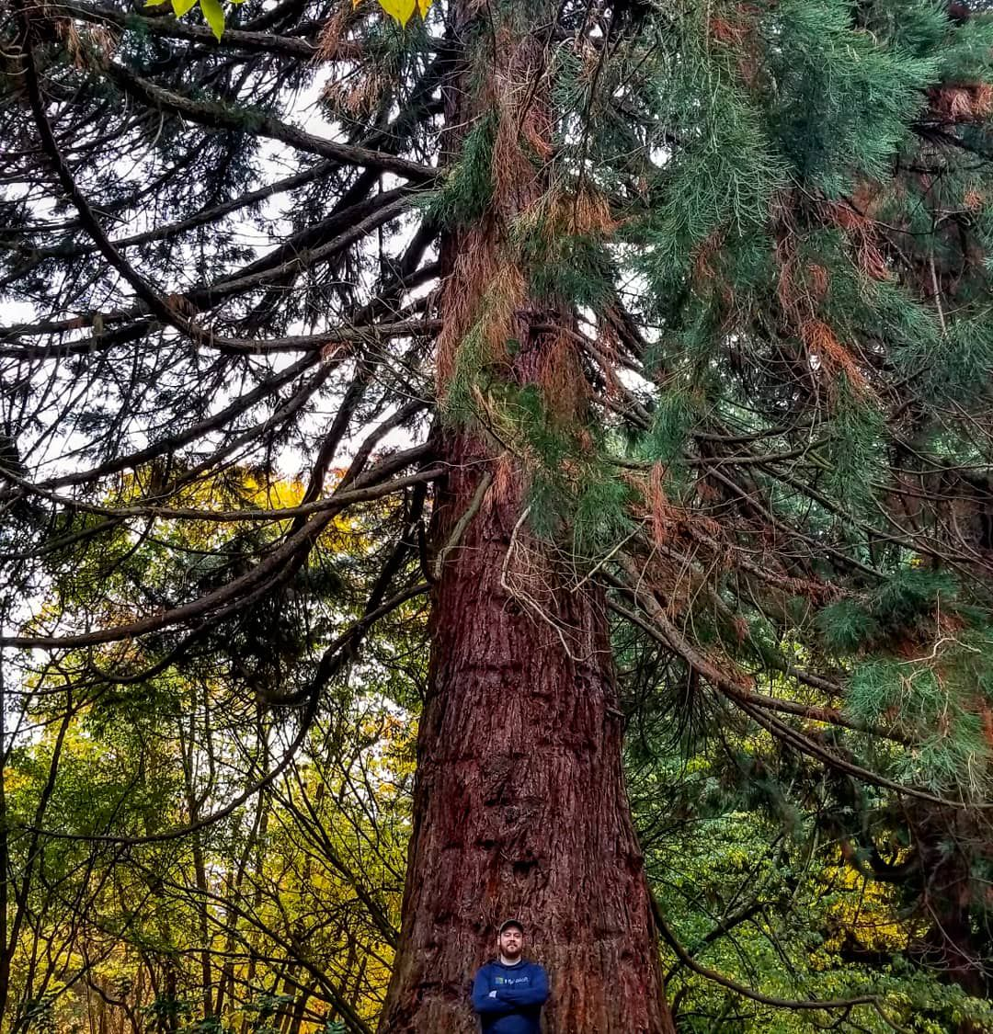

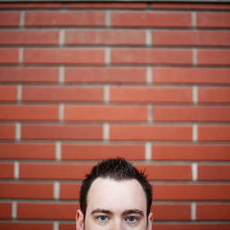
Obligatory Bio Slide
I work at Microsoft on a pretty cool team
I used to work at some other cool places doing cool things, used to be an MVP
You can find me all over the place
@MrThomasRayner
thomasrayner.ca
github.com/thomasrayner
PowerShell Discord/Slack
Join: j.mp/psdiscord or j.mp/psslack
pluralsight.com/authors/thomas-rayner
Master PowerShell Tricks books

Slide 3
Story Time
🐺
I got clawed in the face

Slide 4
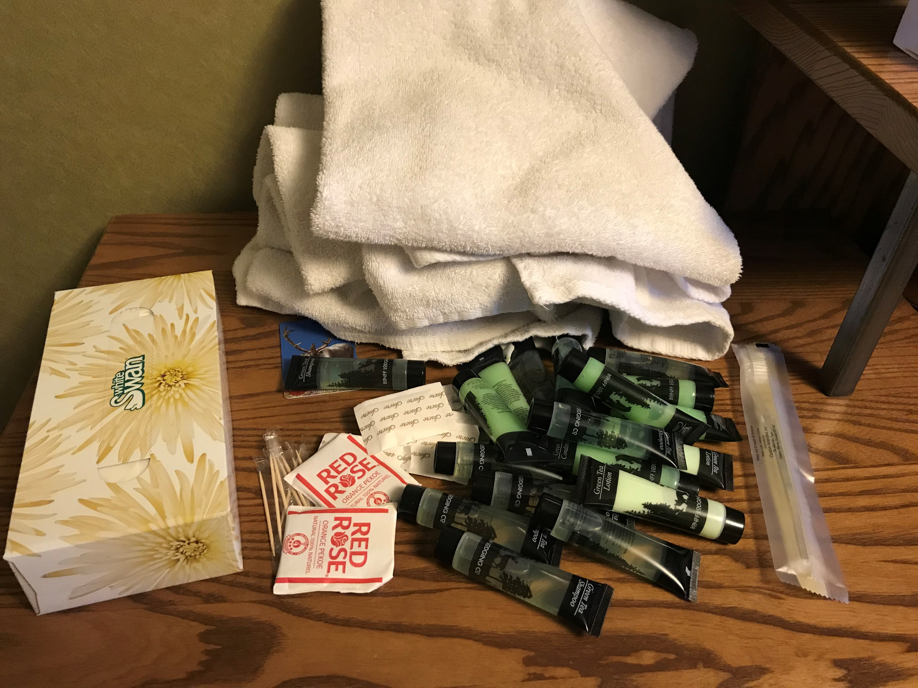

Slide 5
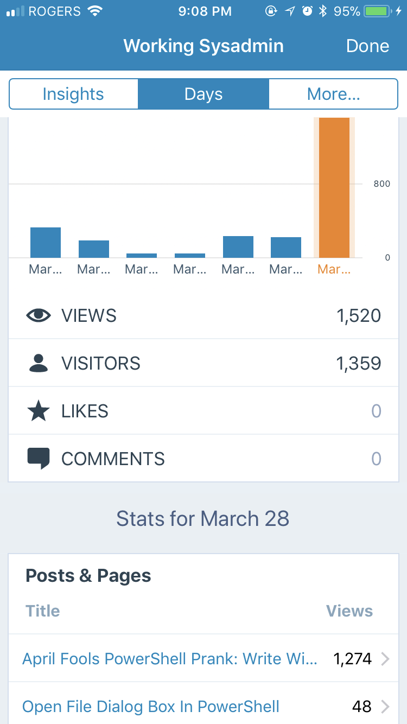

Slide 6
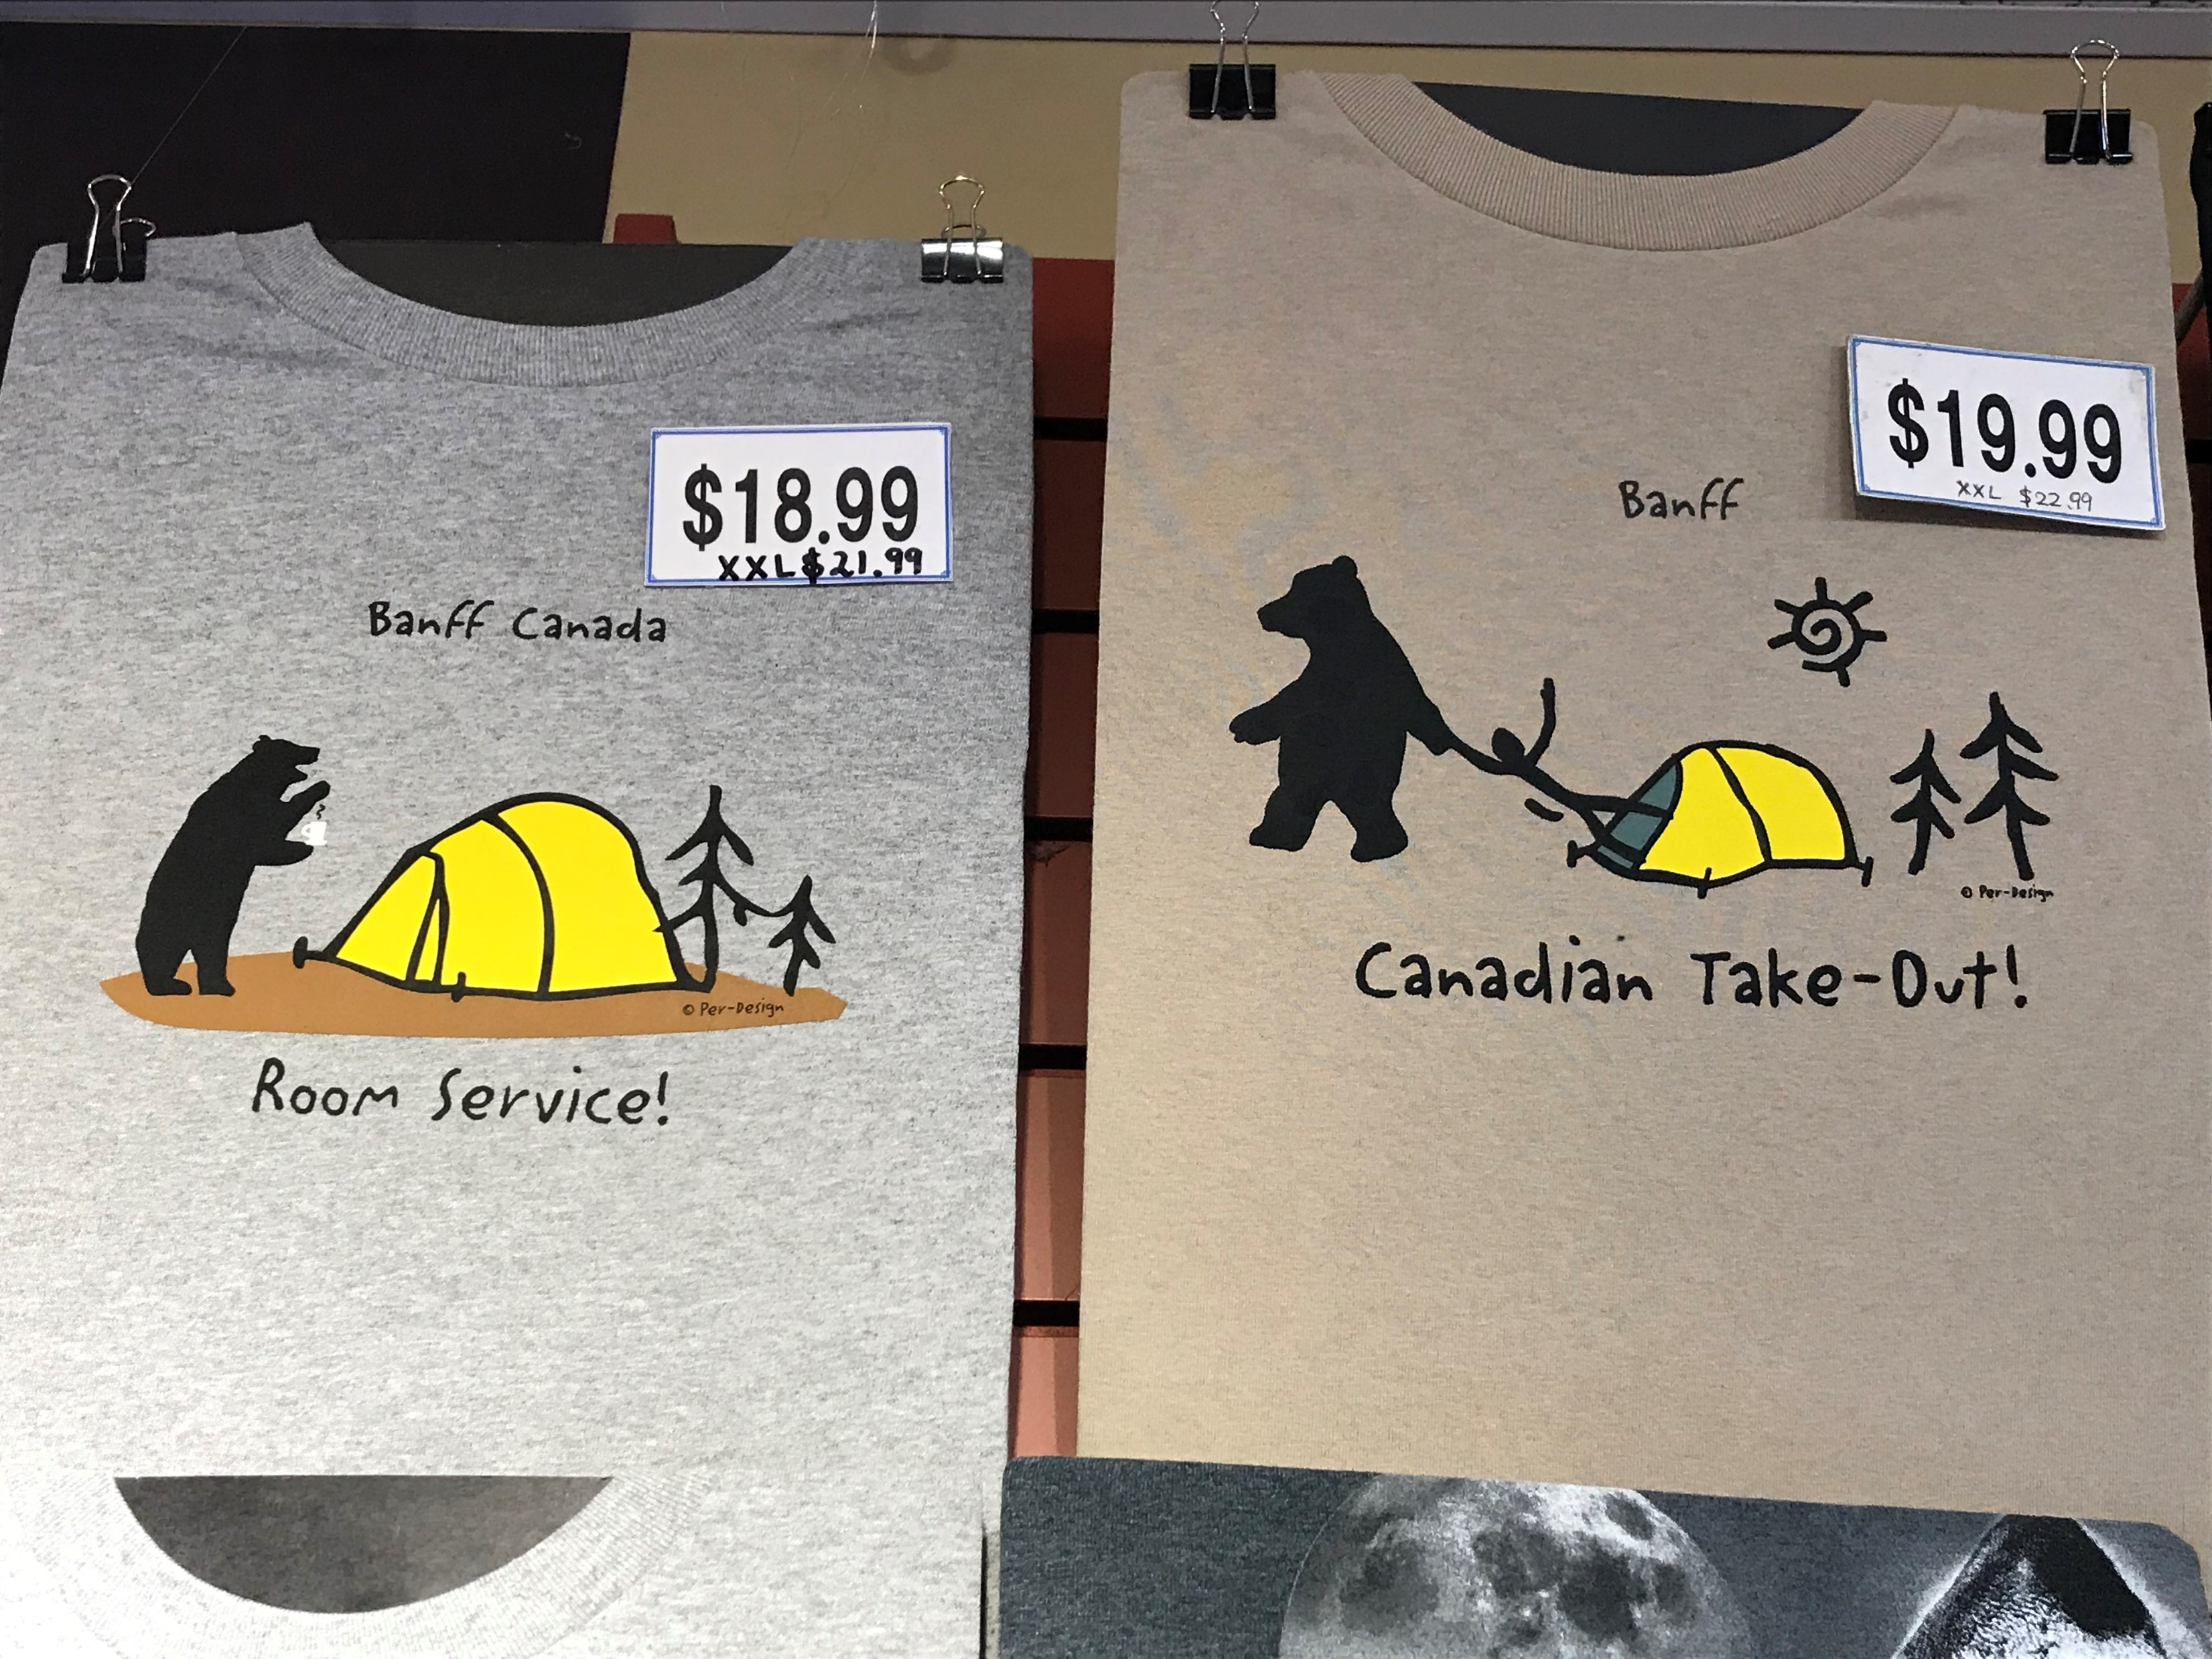

Slide 7
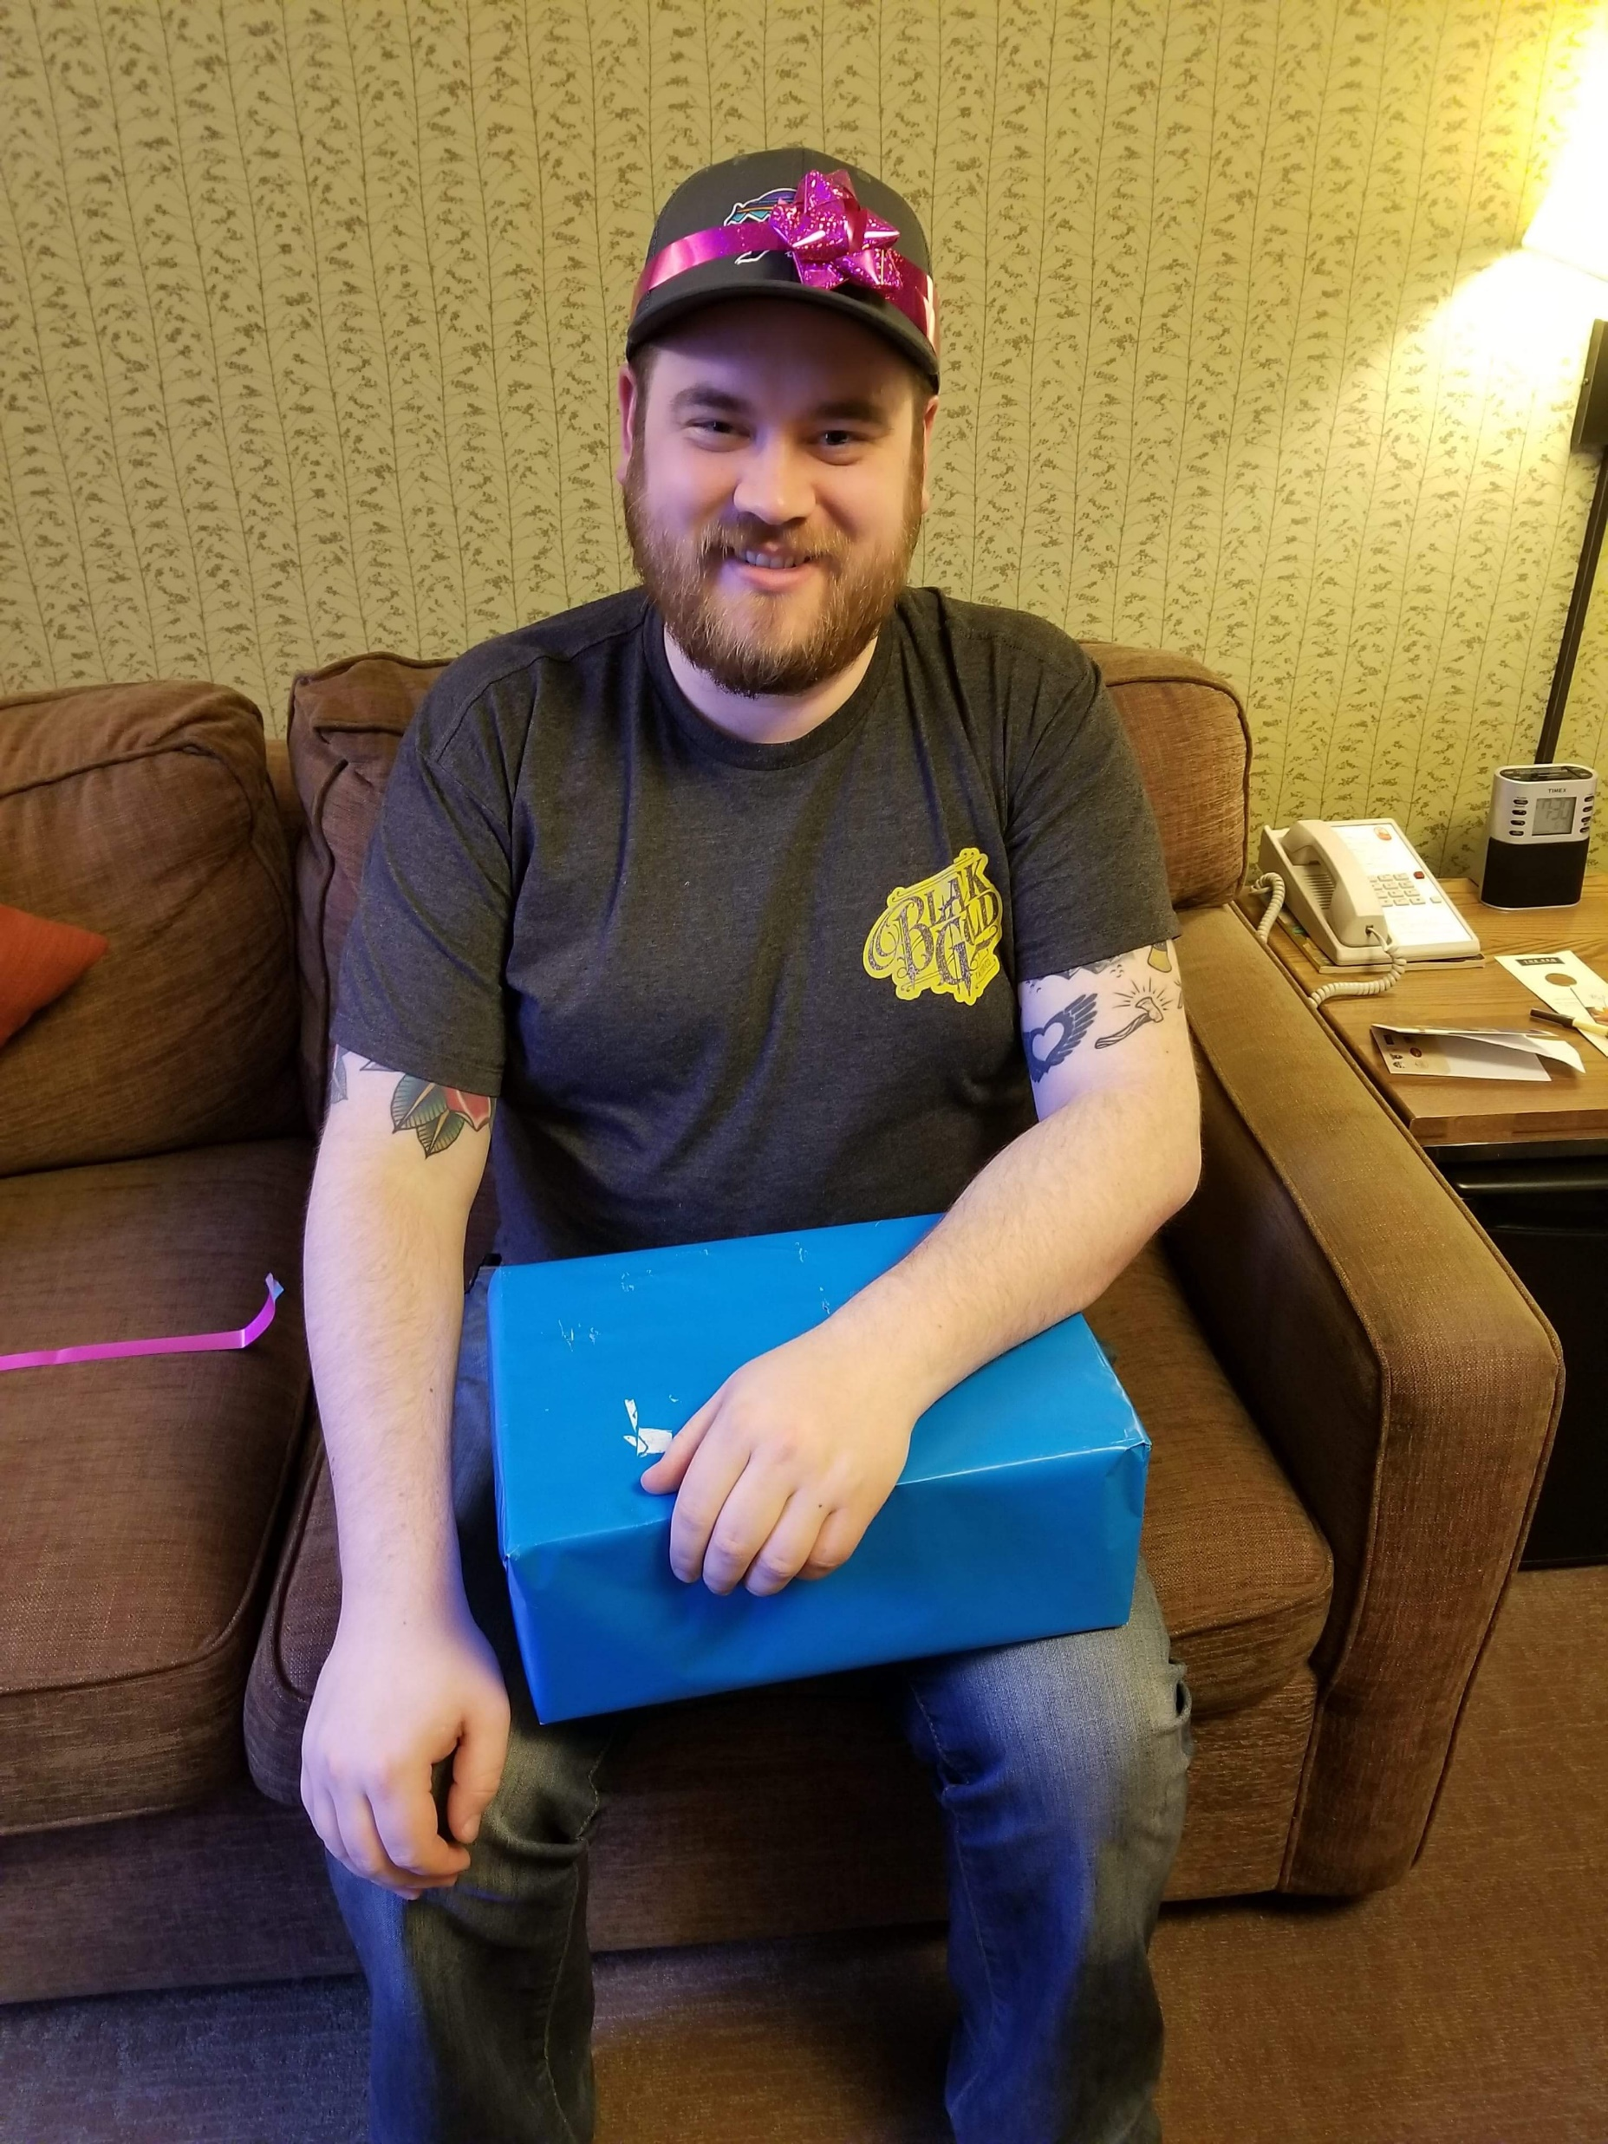

Slide 8
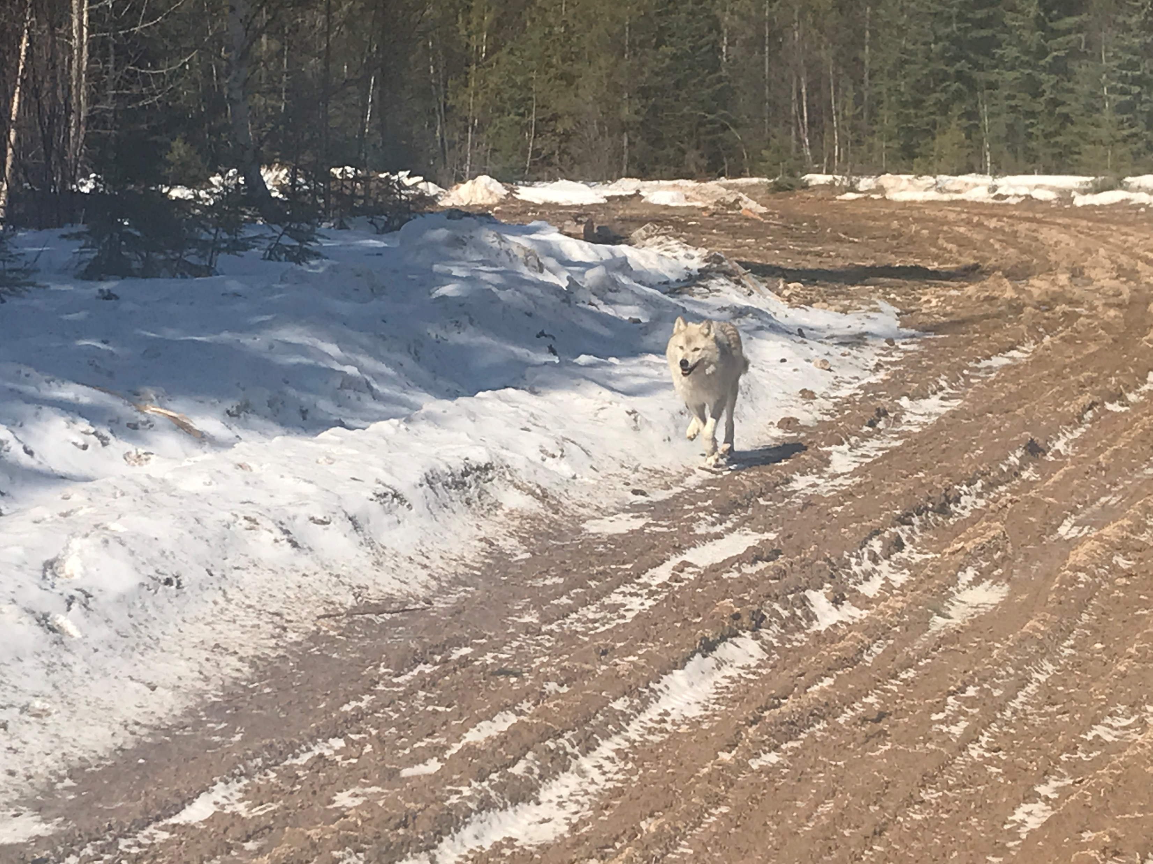

Slide 9
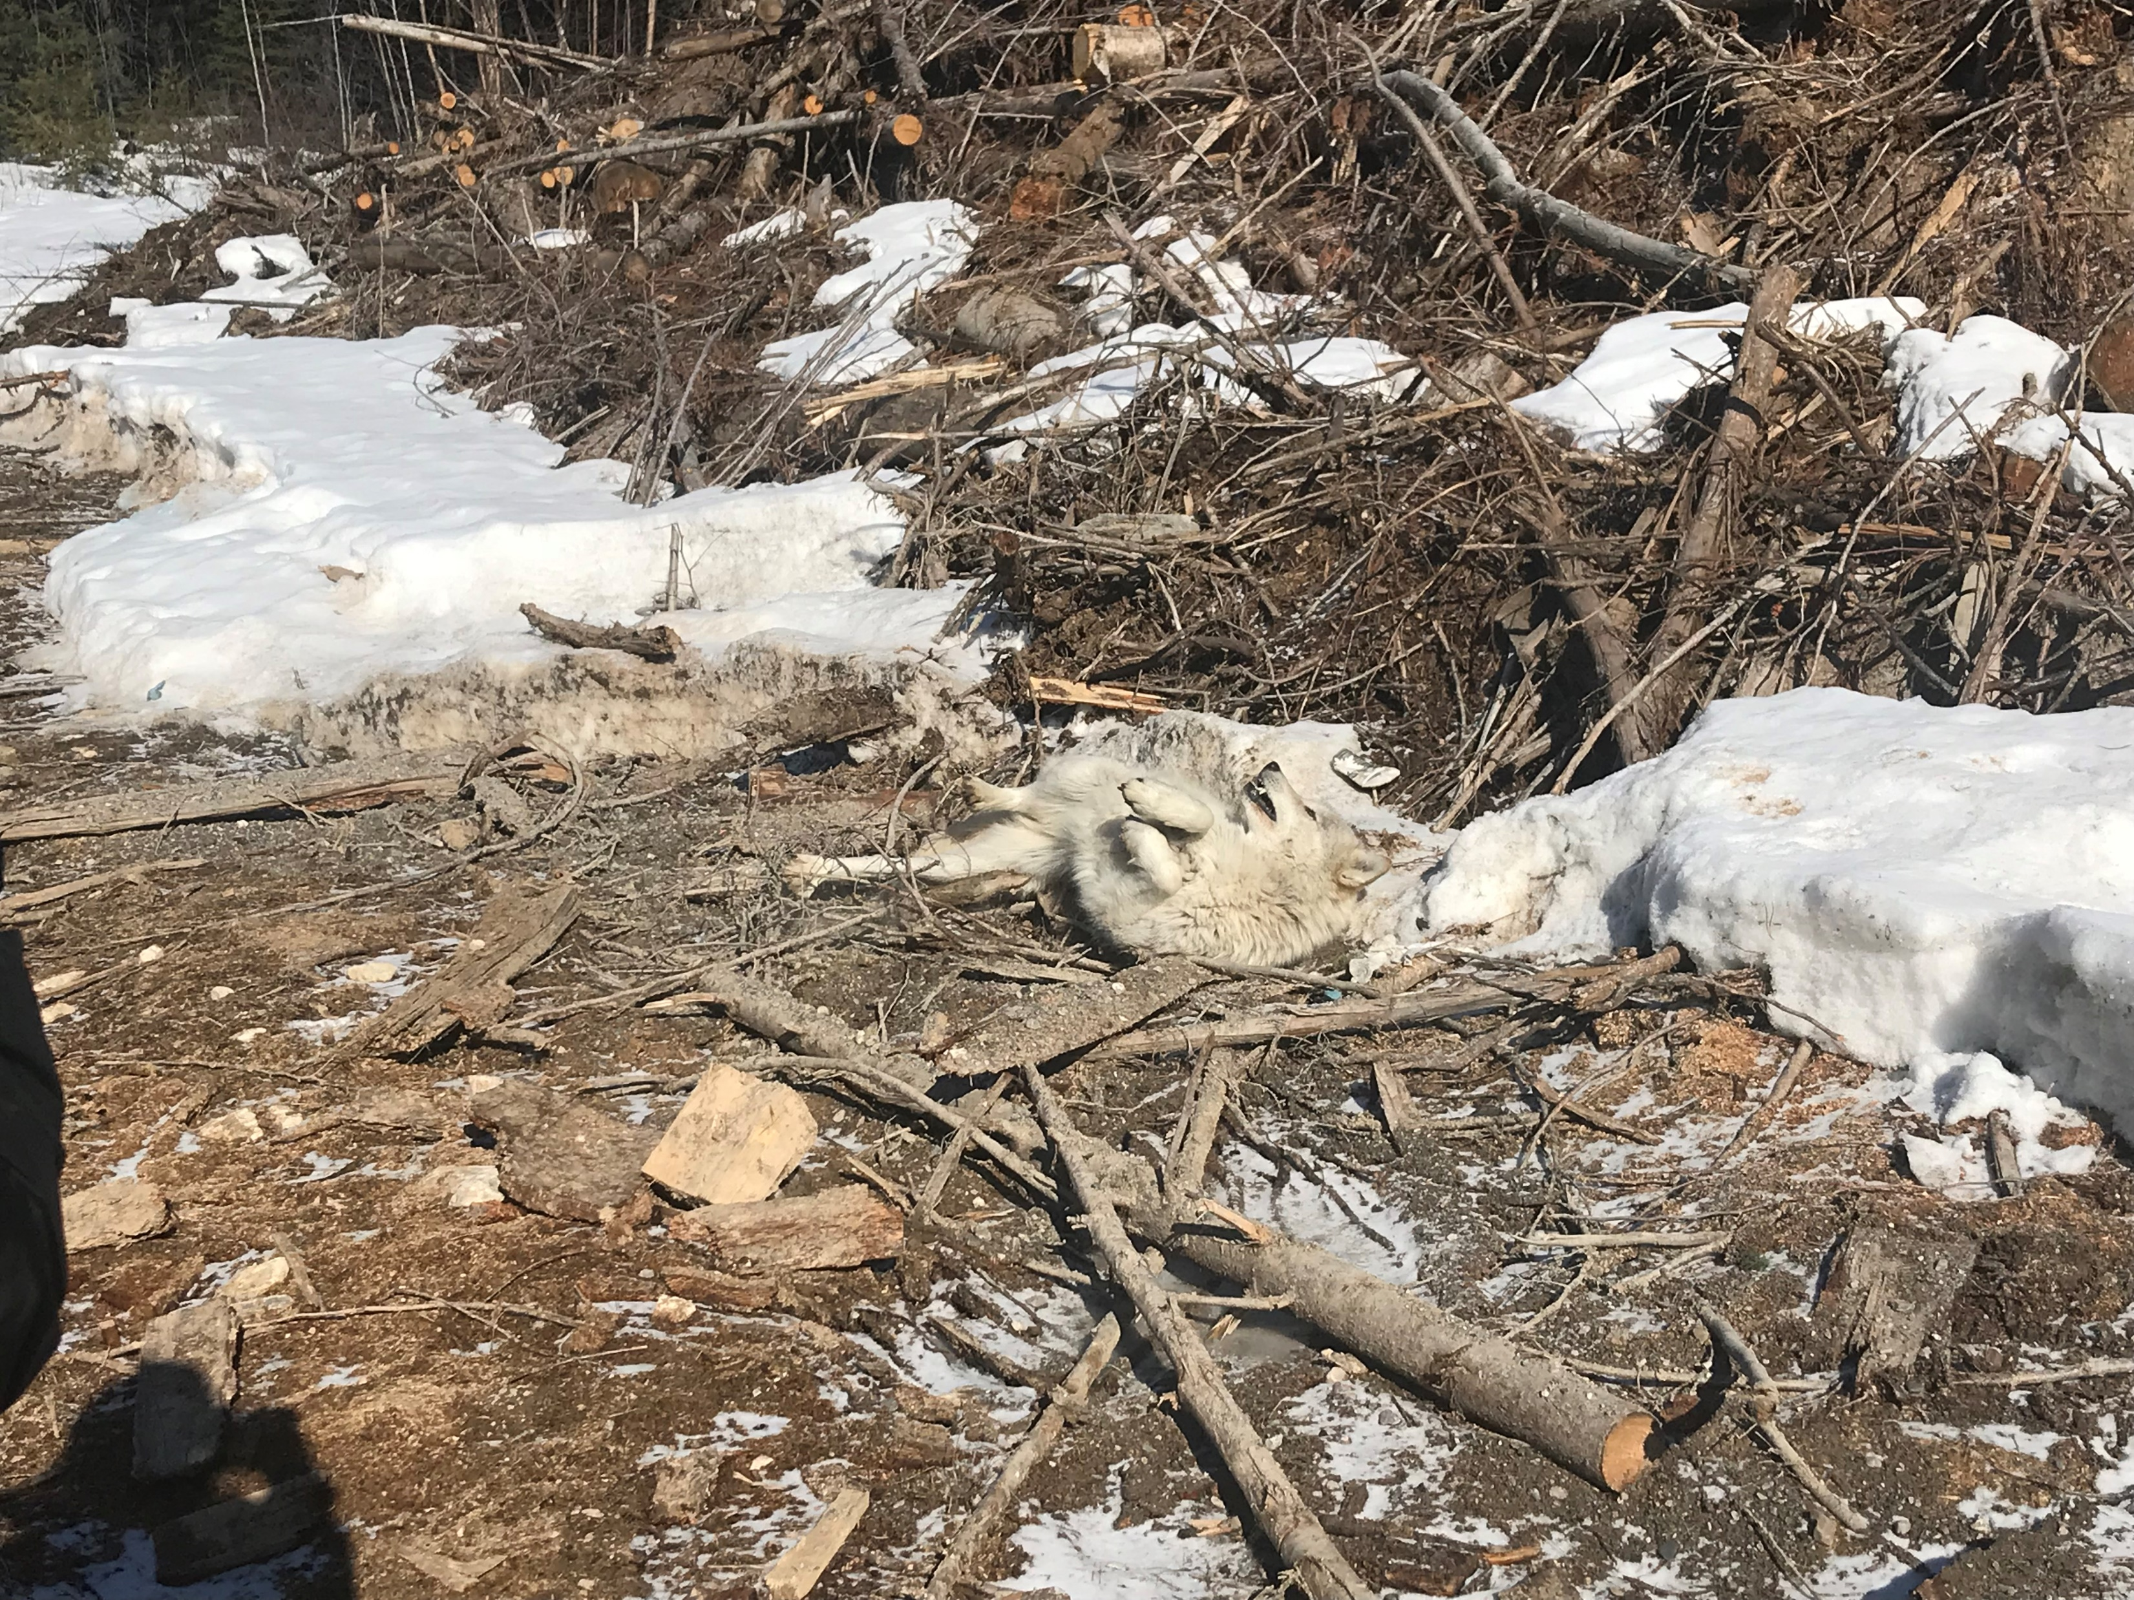

Slide 10
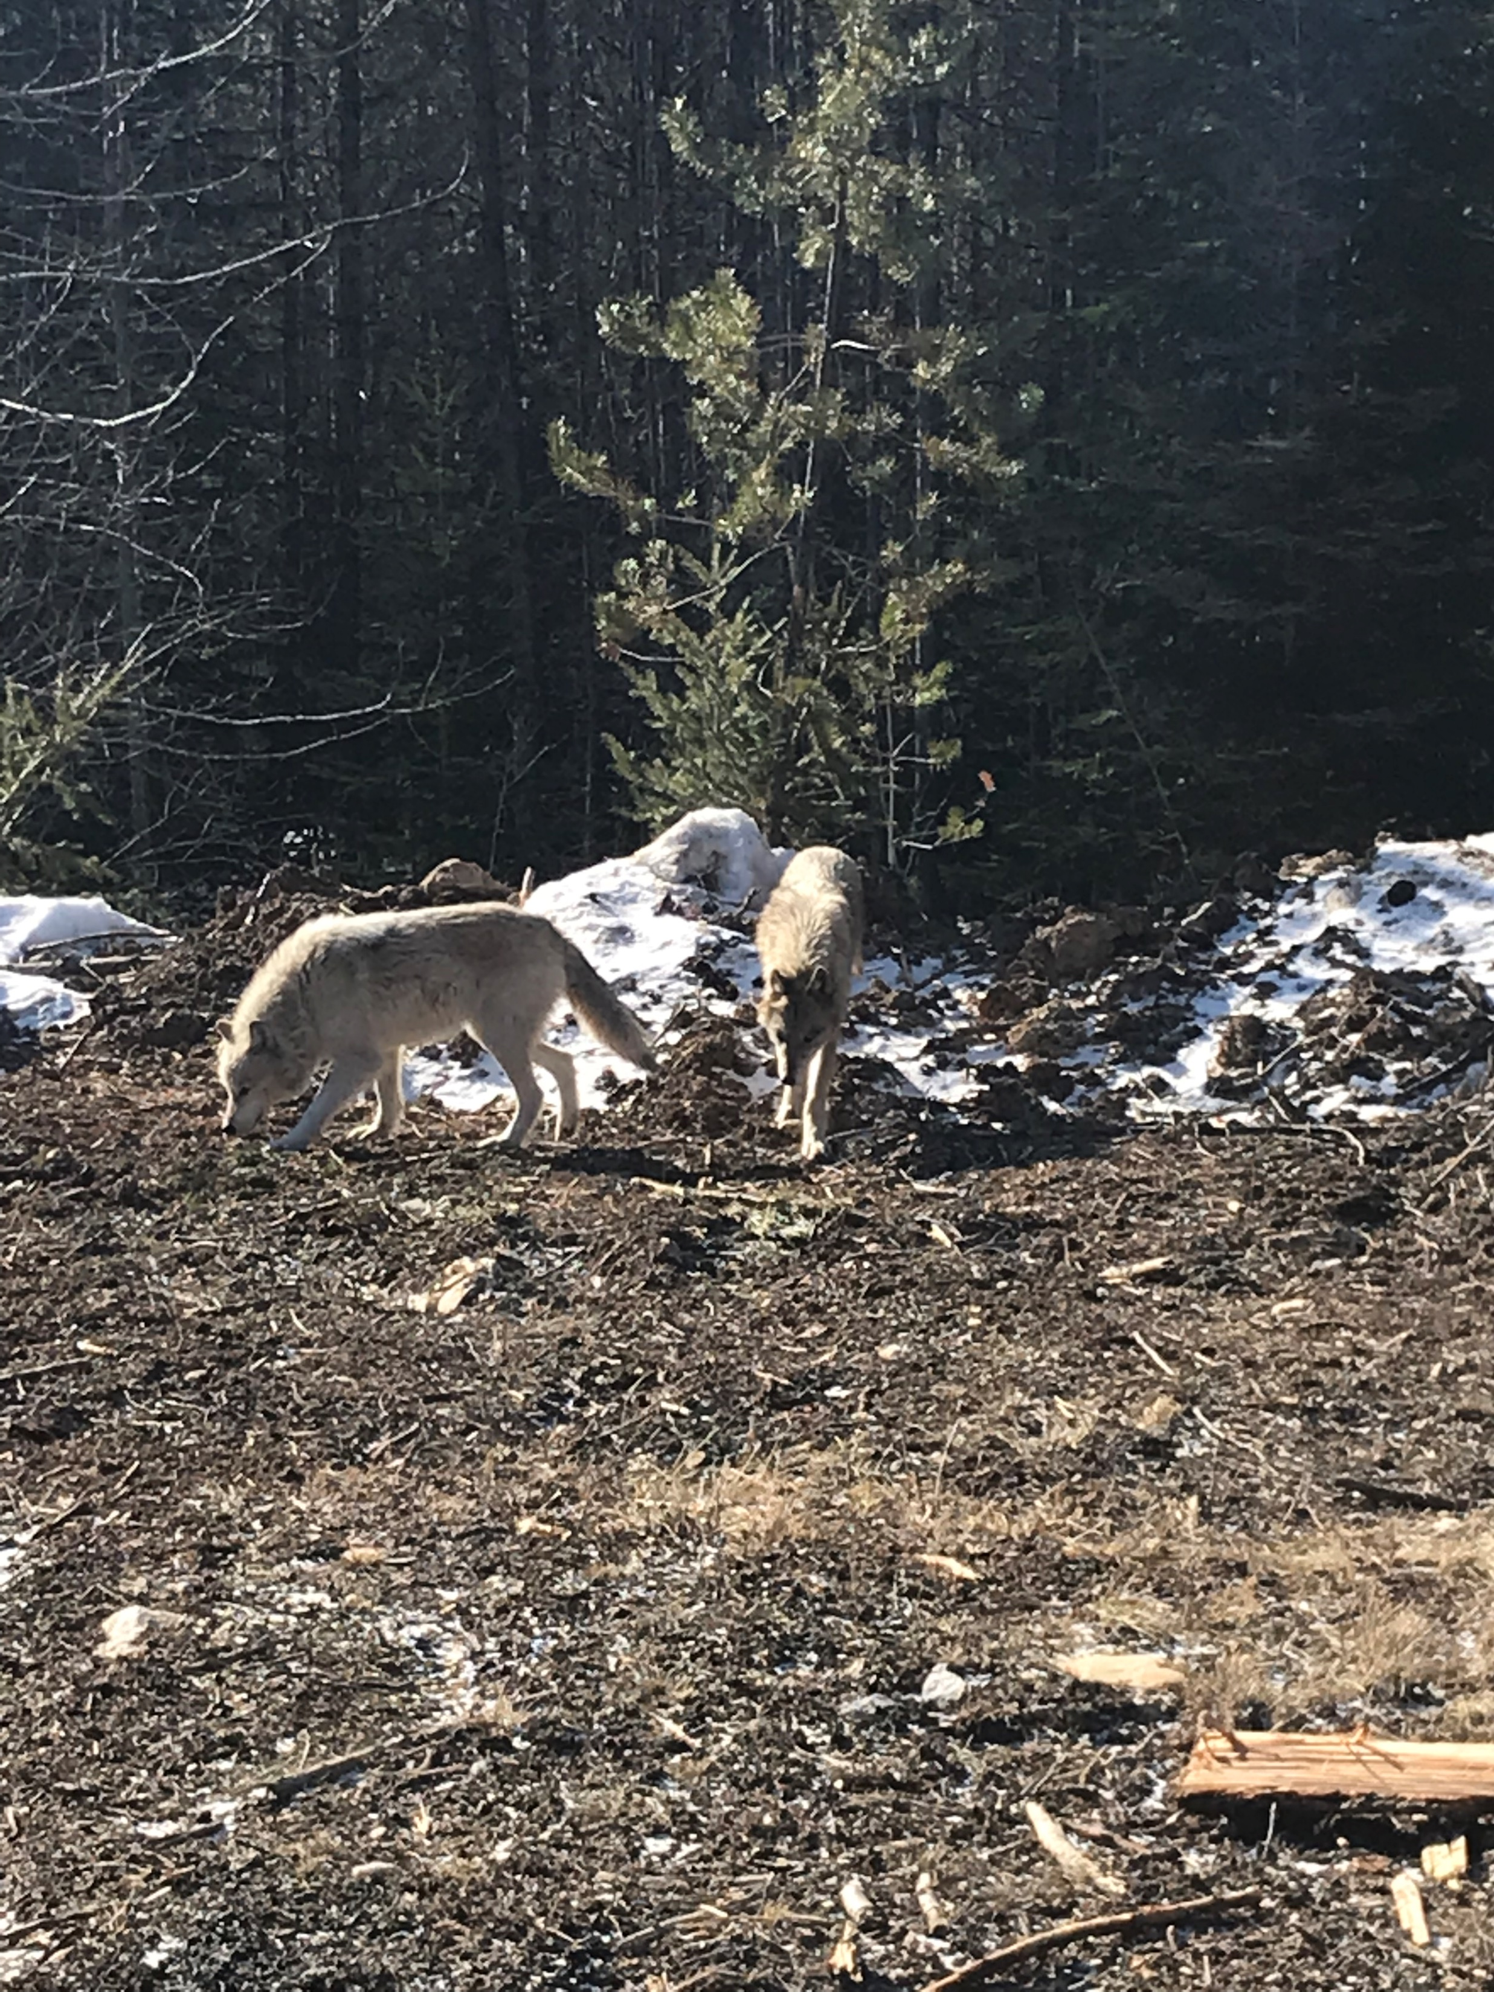

Slide 11
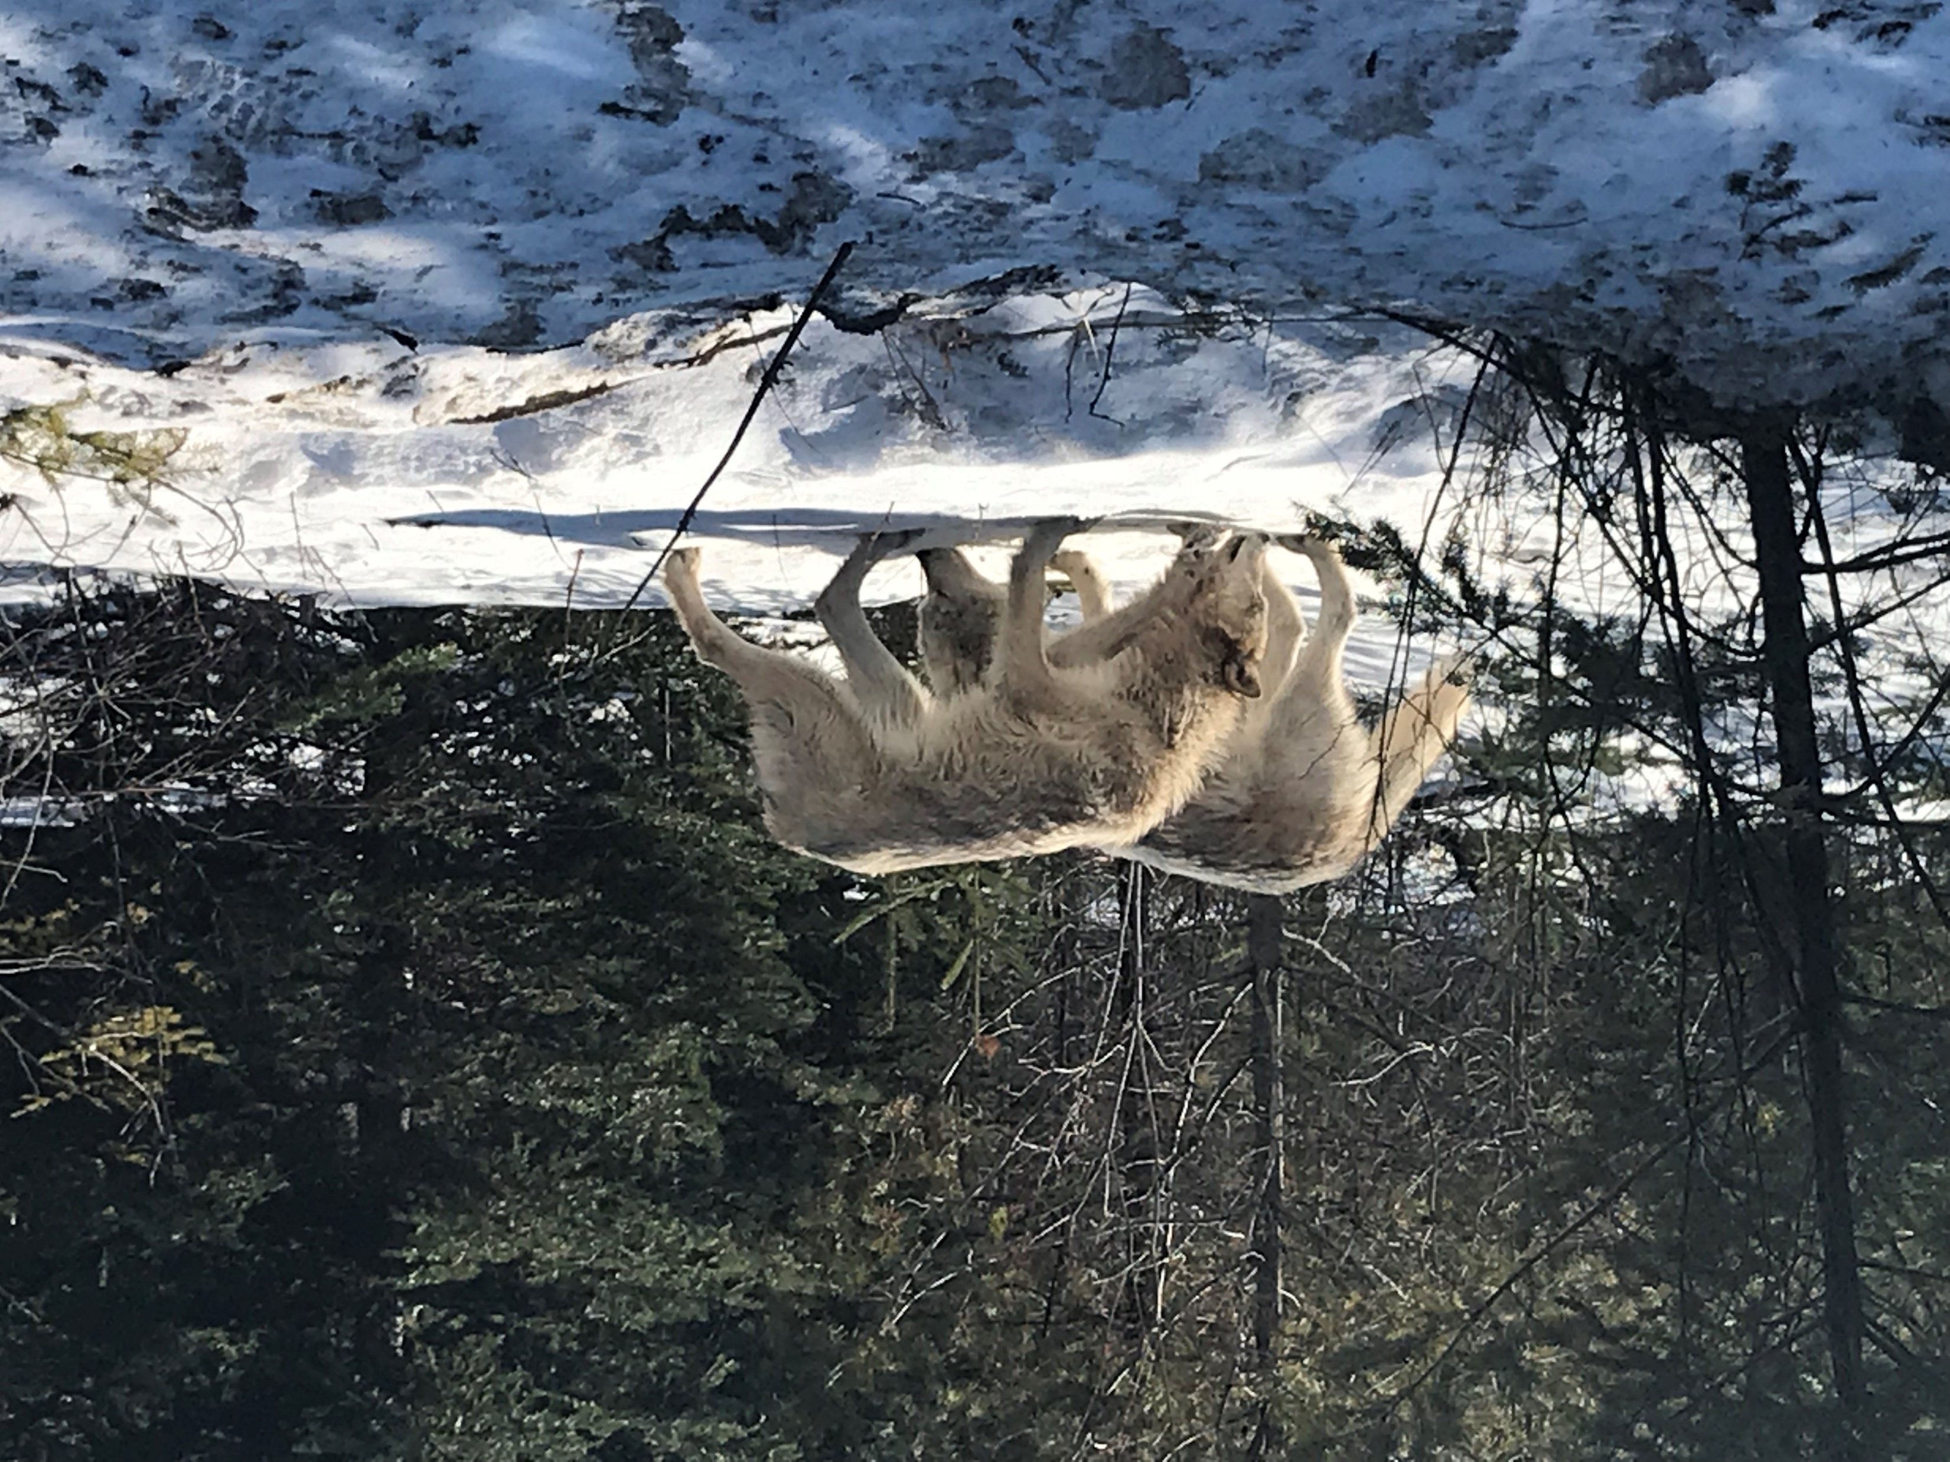

Slide 12
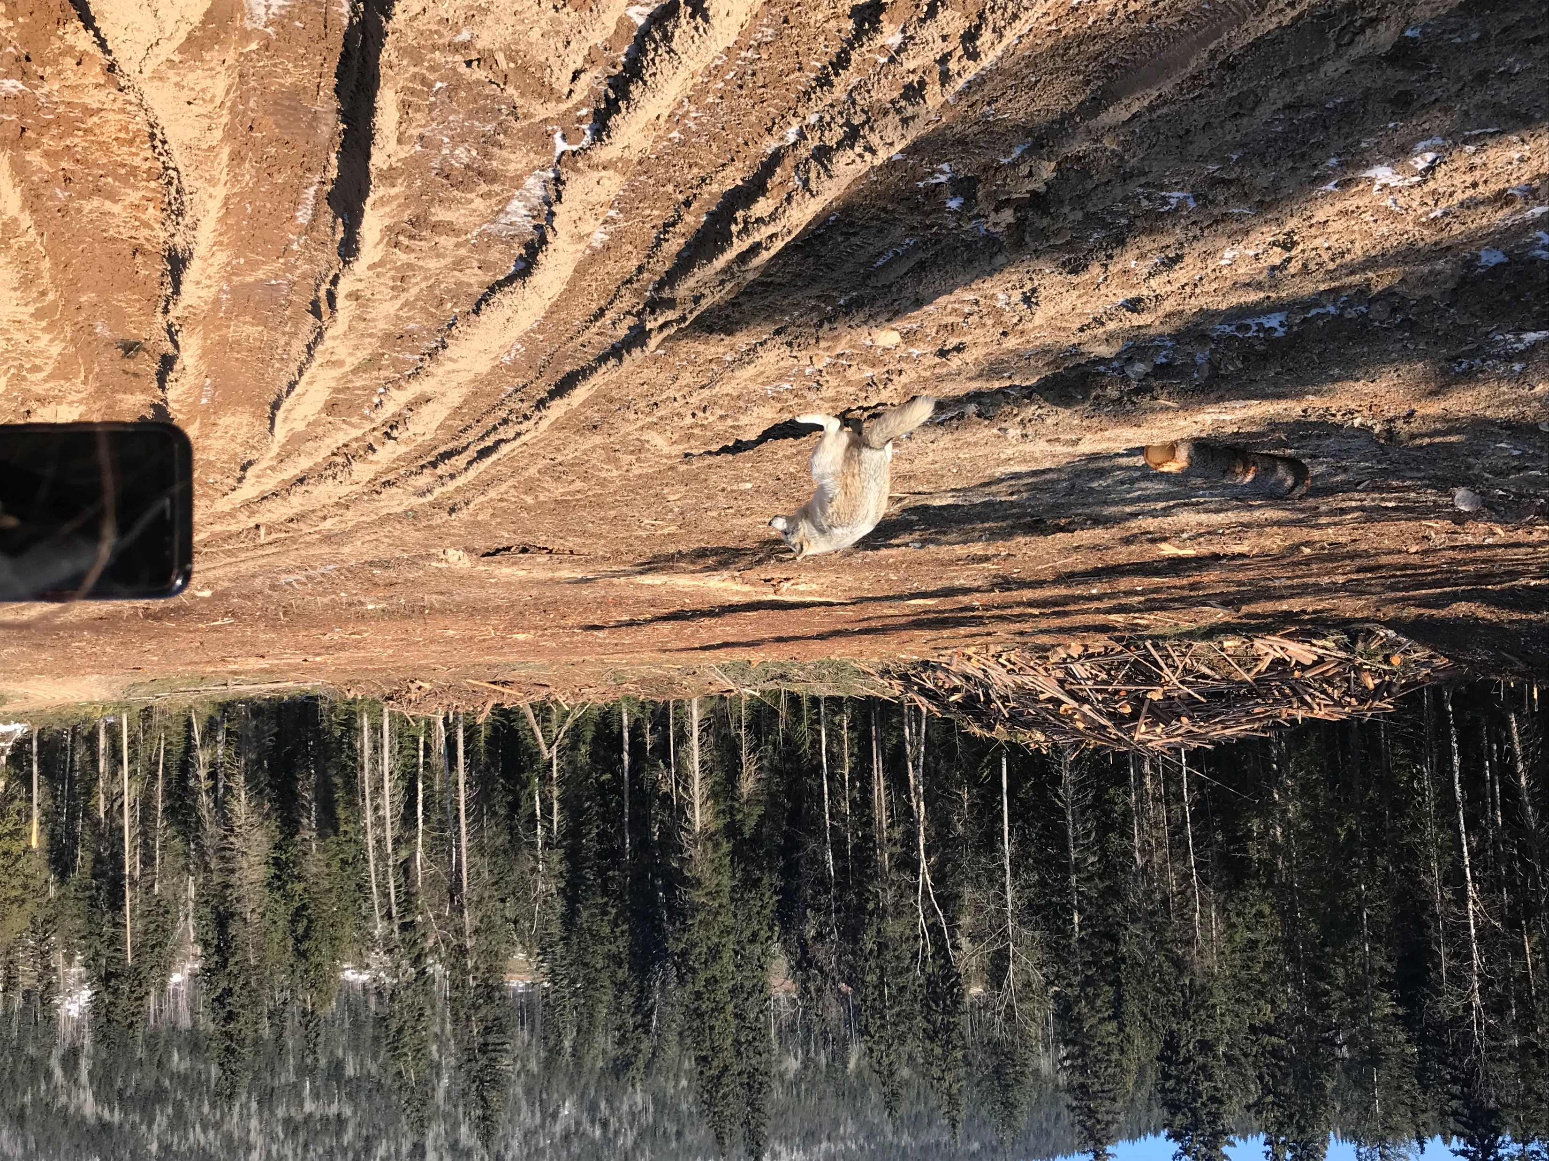

Slide 13
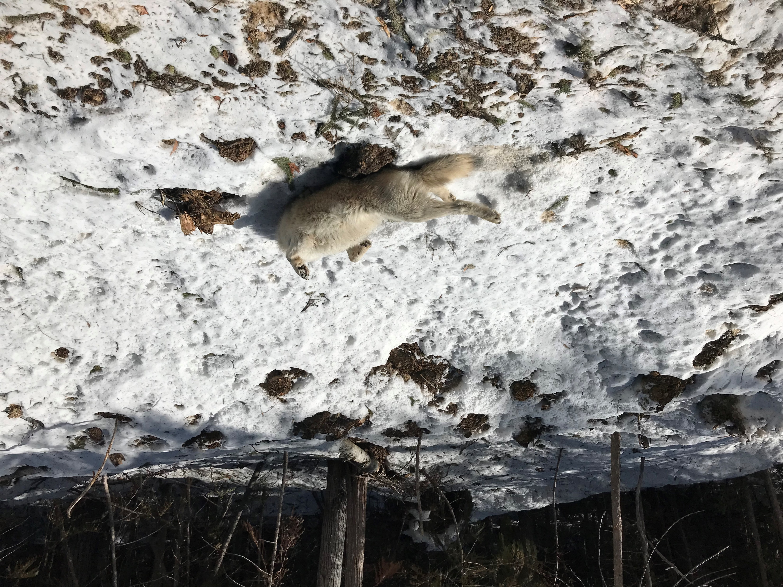

Slide 14
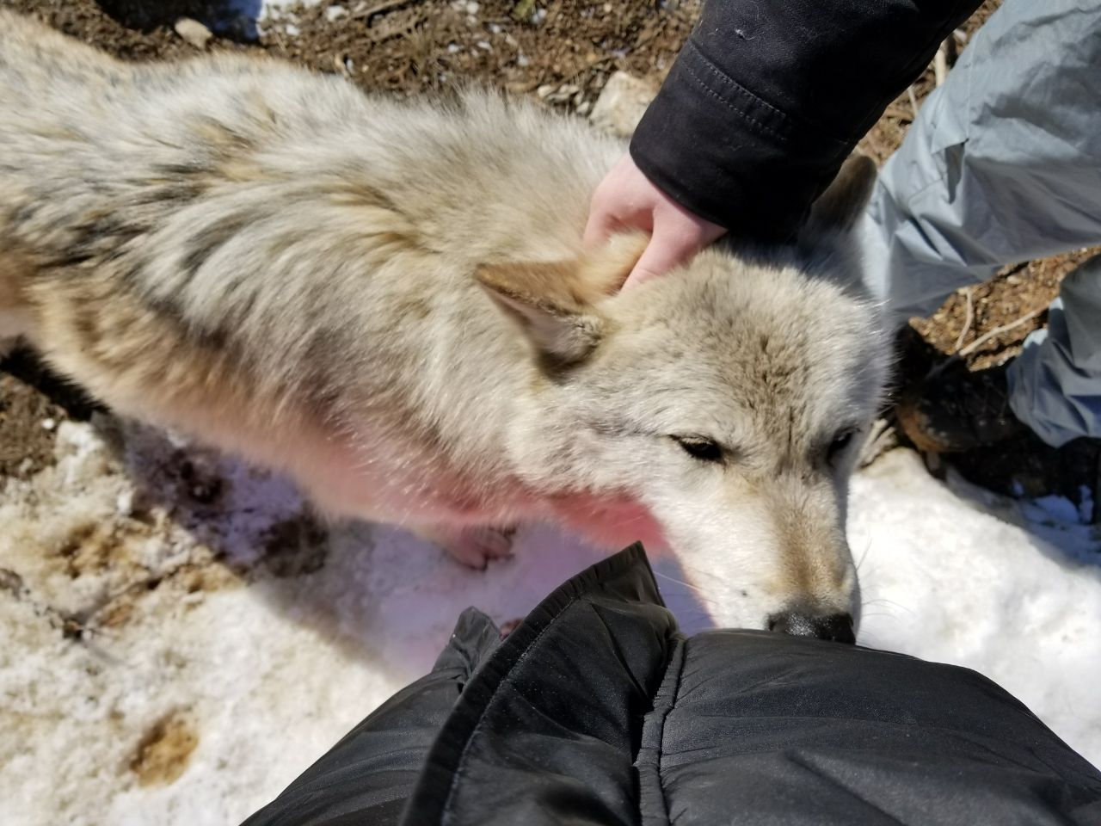

Slide 15
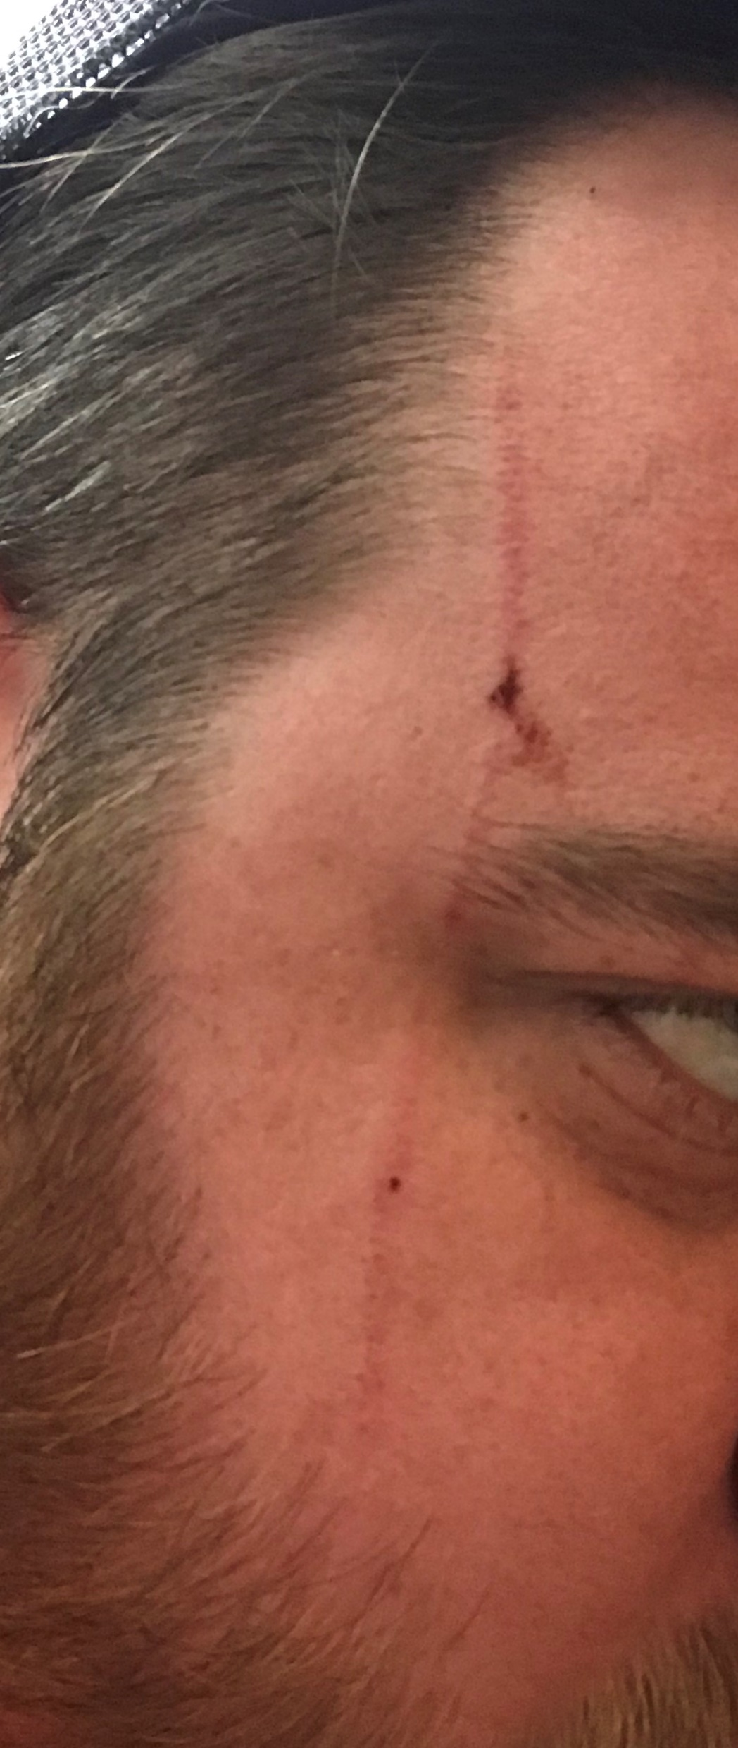

Slide 16
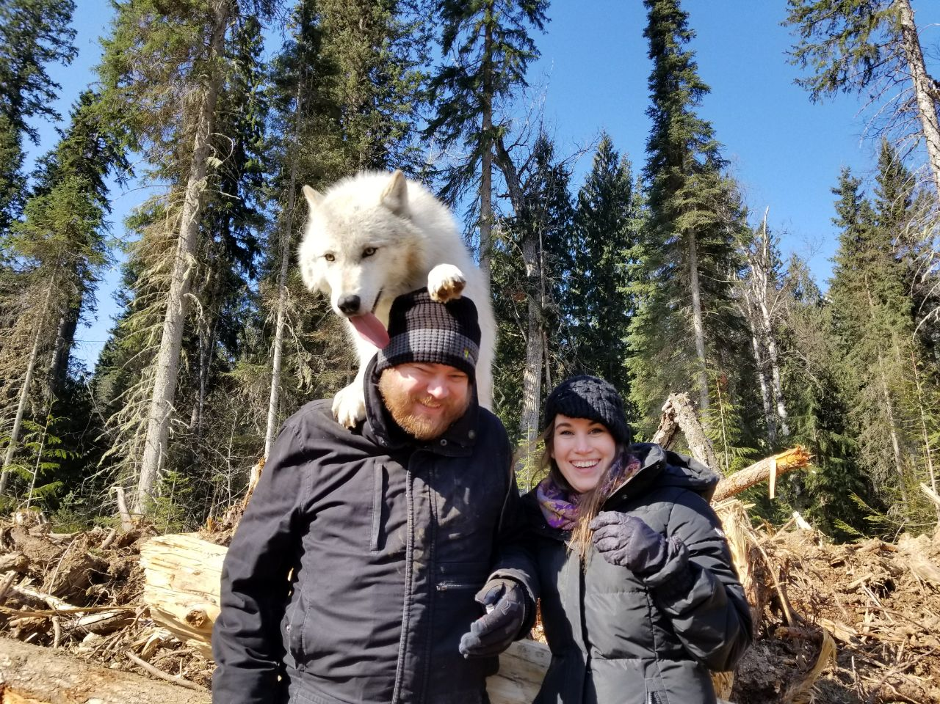

Slide 17
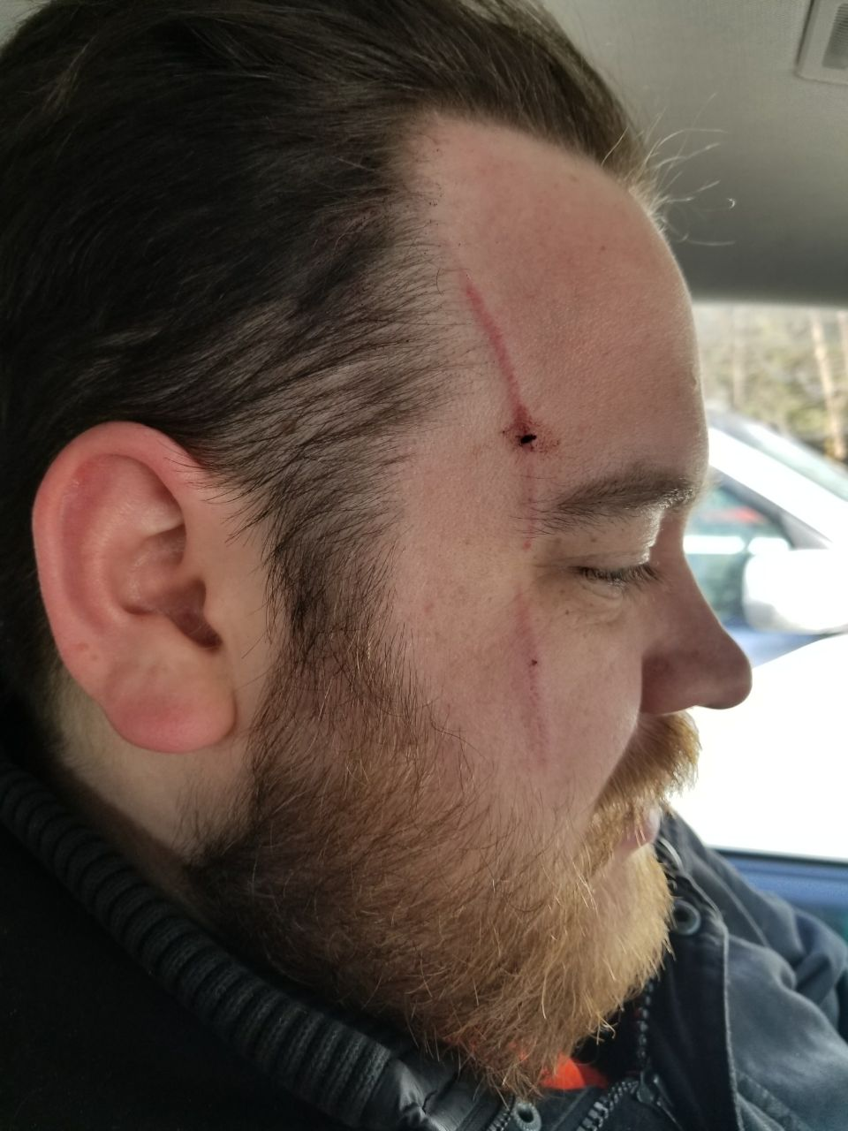

Slide 18
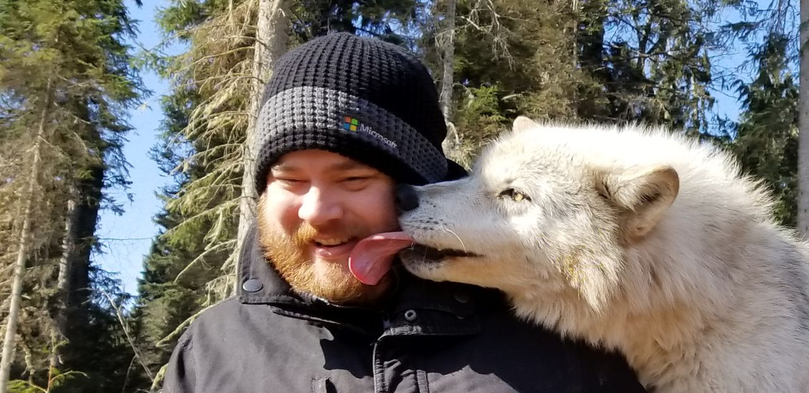

Slide 20
Questions?
@MrThomasRayner
thomasrayner.ca
github.com/thomasrayner
PowerShell Discord/Slack
Join: j.mp/psdiscord or j.mp/psslack
pluralsight.com/authors/thomas-rayner
Master PowerShell Tricks books

